Slide 1
Principal Component Analysis

Slide 2

State of play
Machine Learning: Pandas, NumPy, Matplotlib, sklearn
Regression and Classification and MLP
CNN and LSTM (also coding of these) and exercises
NLP, RNN
PCA
Autoencoders
Maths of Deep Learning

Slide 3
What is PCA?

Slide 4
Problem:
Predict GDP of UK for 2022
You have a large number of data sources:
GDP of previous years
Economic indicators: like the unemployment rate, inflation rate, and so on.
Census data
Survey data
Industrial output
Stock prices
IPOs etc
This leads to a large number of features

Slide 5
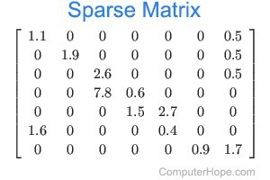
In a nutshell, you have a lot of variables to consider.
Problems:
Overfitting – learns both noise and signal
Sparse data
Unclear relationship between variables

Slide 6
Objective:
focus on only a few variables i.e. reduce the dimension of your feature space.
By reducing the dimension of your feature space, you have fewer relationships between variables to consider and you are less likely to overfit your model.
Based on two broad strategies:
Feature elimination (dropping features)
Feature extraction

Slide 7
Feature elimination is simpler but problematic (which criteria do we use to drop these features?)
Feature extraction takes a different approach. In a nutshell, if you have 20 variables, you create (say) 5 new variables from these 20 such each new (artificial) feature is a linear combination of each of the old variables.
Also, we create these new independent variables in a specific way and order these new variables by how well they predict our dependent variable.

Slide 8
In effect,
This reduces the number of dimensions
But also because new independent variables are combinations of our old ones, we’re still keeping the most valuable parts of our old variables
Finally, we are considering the new variables in order of their importance to predict the dependent variable
After PCA, all the new (artificial variables) are independent of each other
These variables are used for model building instead of the original variables

Slide 9
How does PCA work?
Calculate a matrix that summarizes how our variables all relate to one another.
Break this matrix down into two separate components: direction and magnitude.
Direction – represents the orientation in which our data is more dispersed
Magnitude – represents how important each direction is

Slide 10
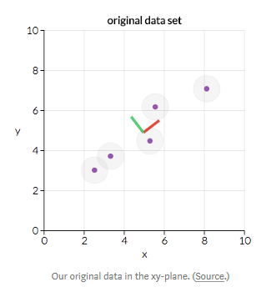
Here, the “red direction” is the more important one because it represents the line which best fits the data

Slide 11
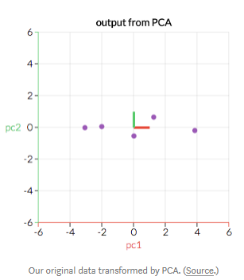
We transform our original data to align with these important directions (which are combinations of our original variables).
This can be in n dimensions
Identify which “directions” are most “important,”
Compress or project our data into
a smaller space

Slide 12
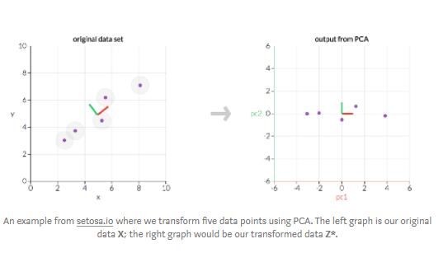

Slide 13
We transform our original data to align with these important directions (which are combinations of our original variables).
This can be in n dimensions
Identify which “directions” are most “important,”
Compress or project our data into a smaller space
Drop the “directions” that are the “least important.”
By projecting our data into a smaller space, we reduce dimensionality of our feature space…

Slide 14
PCA in terms of Eigenvectors
The covariance matrix is a matrix that contains estimates of how every variable relates to every other variable.
Eigenvectors represent directions of dispersal of data.
Eigenvalues represent magnitude, or importance. Bigger eigenvalues correlate with more important directions.

Slide 15
Variability in a particular direction correlates with explaining the behavior of the dependent variable. More variability usually indicates signal, whereas little variability usually indicates noise. In other words, the more the variability there is in a particular direction, it is of significance and therefore something you want to detect.
PCA is an orthogonal linear transformation that transforms data to a new coordinate system such that the greatest variance on some projection of data lies on the first principal component – the second greatest variance on the second component – and so on

Slide 16
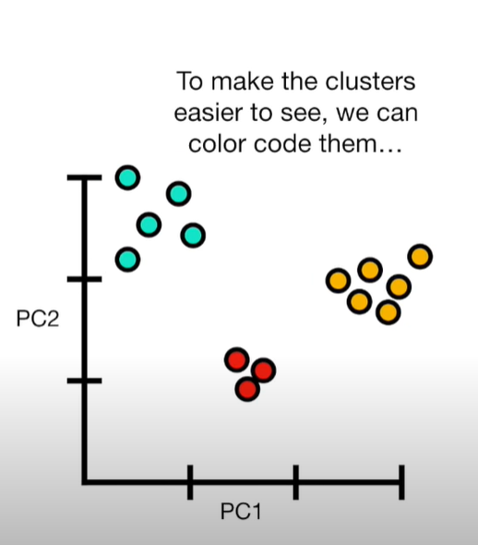
PCA plot converts the correlation or lack thereof into a 2 d graph. Cells that are highly corelated cluster together.

Slide 17
Source adapted from: https://towardsdatascience.com/a-one-stop-shop-for-principal-component-analysis-5582fb7e0a9c
Video
https://www.youtube.com/watch?v=HMOI_lkzW08
For eigen vectors: https://www.youtube.com/watch?v=PFDu9oVAE-g

